Slide 1
Information Session + Q&A for Students Writing Graduation Theses (영어영문학과)
Thursday, 9/17/2026, 6:30 p.m., 학관 553호

Slide 2
Agenda
1) Key Information: What & Where?
2) How to Get Started
3) Key Requirements—Highlights of the Notices and Guidelines
4) Q&A

Slide 3
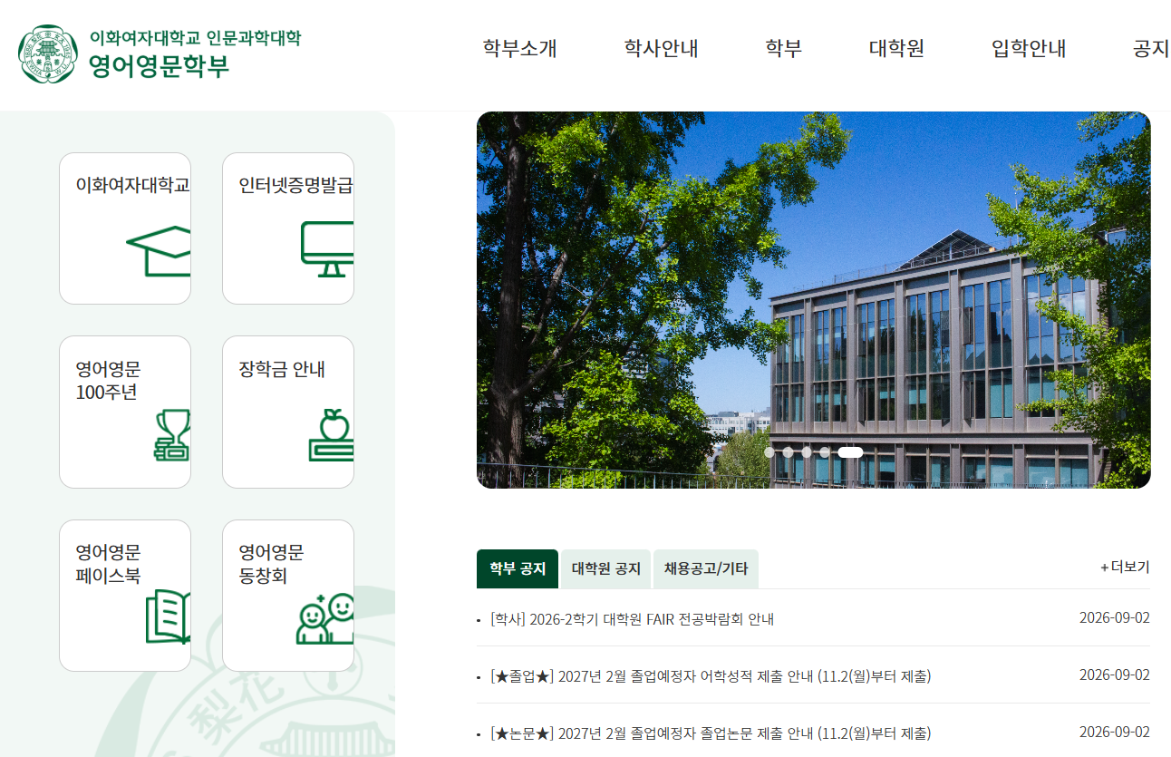
Key Information
https://english.ewha.ac.kr/
Notices on the English Dept. homepage + attached files.

Slide 4
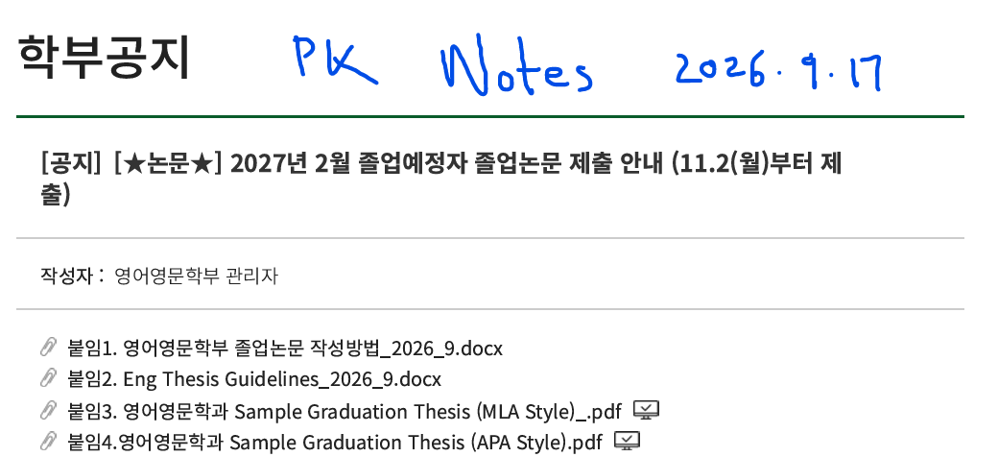
The Thesis Writing Process
Point #1: Follow procedures on the guidelines. Use the sample papers to help guide you with format and style.

Slide 5
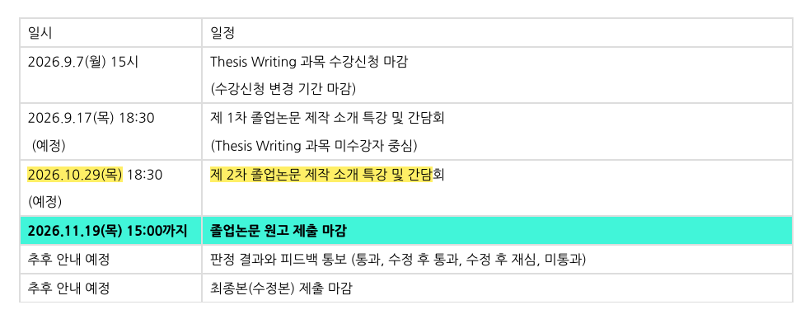
The Thesis Writing Process
Point #2: Don’t get behind schedule. Try to write most of the paper by the 2차 간담회 date (October 29).
Then you can come to the 2차 간담회, ask questions about any problems you are having, and still have 2 weeks to fix your problems before the due date (November 19).

Slide 6
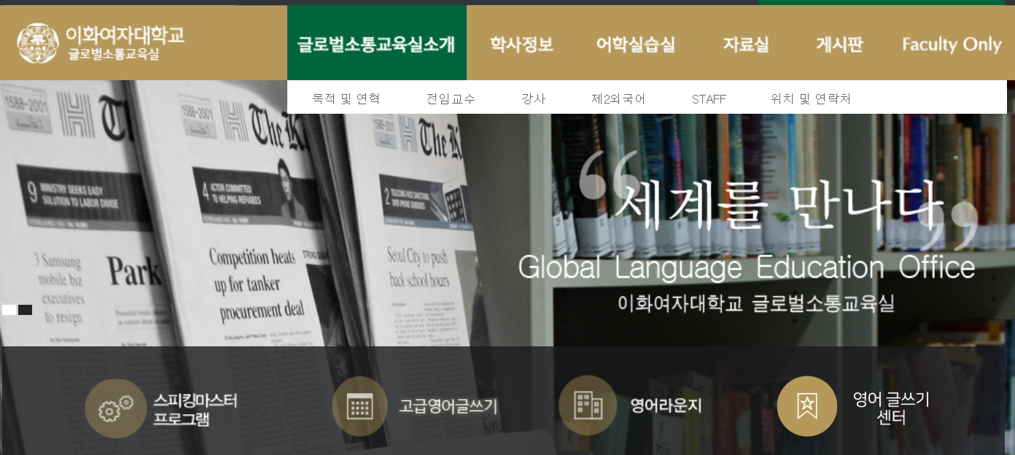
The Thesis Writing Process
Point #3: Get help when you need it. Don’t isolate yourself.
a. Ask a professor.
b. Use the Writing Center (epo.ewha.ac.kr).

Slide 7
Ways to Get Started: Literature
1) Choose a work of literature that you like (a novel, a play, a movie, a TV show, a video game) or possibly about a set of 3 or 4 short poems or songs by the same writer.
2A) Easiest Method: Apply Theory A to Text B (the sample paper by Huang Tzu Tung does this)
example: apply Laura Mulvey’s theory of the male gaze (from her 1975 paper about Alfred Hitchcock’s movie Rear Window) to your own analysis of a movie you like or dislike—e.g.: K-Pop Demon Hunters
2B) Second Easiest Method: Disagree With Theory A in relation to Text A (requires deep understanding of the theory)
example: disagree with Mulvey’s theory and re-analyze Rear Window to show your own view

Slide 8
Ways to Get Started: Linguistics
1) Think of a theory you learned about in a linguistics class that you could test on your own.
Phonology: Make recordings of people reading or saying specific words/passages to test something like changes in speed, aspiration, etc.
Syntax or Pragmatics:
a. Use a computer program to identify grammar or usage patterns (from the digital lab, or just an AI program—like the sample paper by 이민경 does).
b. Do a survey to discover people’s speaking or writing patterns or attitudes about certain types of language.
Key Point for Linguistics or Literature: You must analyze something (called your primary source). Try to decide what it is before you start reading secondary sources.

Slide 9
Notes on the Announcement

Slide 10
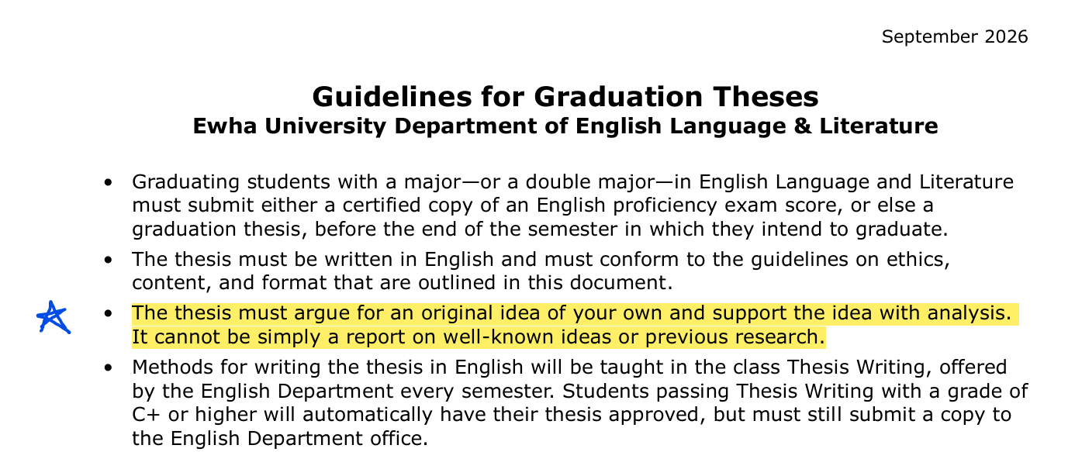
Notes on the Guidelines
Don’t just rely on my highlights. Read the whole thing. 영문 판 대신 한국어로 읽어도 괜찮아요.

Slide 11
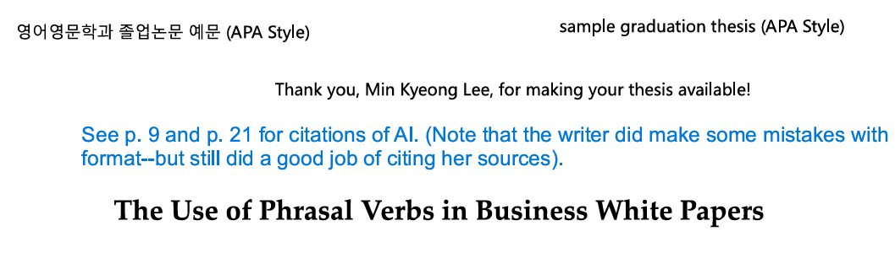
Notes on Citing AI in a Paper

Slide 12
Q&A
Things you might want to ask about:
1. the requirements given in the guidelines
2. your ideas
3. your actual writing (if you started—and can download to the main computer quickly, to show us)
4. finding sources to cite
5. technical stuff about formatting the paper, citing sources, etc.

Slide 13
Extra: Which Thesis Statements Sound Good for a Thesis Paper in the English Department?
1. The Great Gatsby criticizes American materialism.
2. The Great Gatsby shows us how politeness and decorum in both language and behavior act as gatekeepers to the wealth and power of the upper class.
3. My experiment tested listeners’ comprehension of six different speakers and found that comprehension by native speakers did not decrease, regardless of how much shorter the aspirated consonants were, but did decrease if the consonants were dropped entirely.
4. I found that Korean learners of English were likely to learn faster if they felt they had common hobbies and interests with their teachers.

Slide 14
Extra: Which Thesis Statements Sound Good for a Thesis Paper in the English Department? Answers
1. The Great Gatsby criticizes American materialism. No, this is just common knowledge—not an original idea.
2. The Great Gatsby shows us how politeness and decorum in both language and behavior act as gatekeepers to the wealth and power of the upper class. Probably yes. (if it’s true, and if no one wrote that paper already—I suspect that both those conditions are true).
3. My experiment tested listeners’ comprehension of six different speakers and found that comprehension by native speakers did not decrease, regardless of how much shorter the aspirated consonants were, but did decrease if the consonants were dropped entirely. Yes (Note that you have to do the experiment. I don’t know if those would be the results—I just invented a possible experiment and result.)
4. I found that Korean learners of English were likely to learn faster if they felt they had common hobbies and interests with their teachers. No. This is purely about English Education in Korea—not about English language or culture.

Slide 15
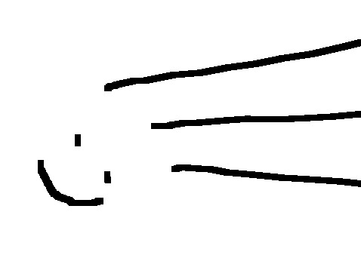
Reminders:
1. Get started early.
2. If in doubt, ask a professor before it’s too late.
Good Luck!

