Slide 1
Information Session for Students Writing Graduation Theses (영어영문학과)
Tues., 9/9/2025, 6:30 p.m., 학관 552호

Slide 2
Contents of the Talk
1) The Thesis Writing Process
2) Research Tips
3) Avoiding Plagiarism
4) Q&A

Slide 3
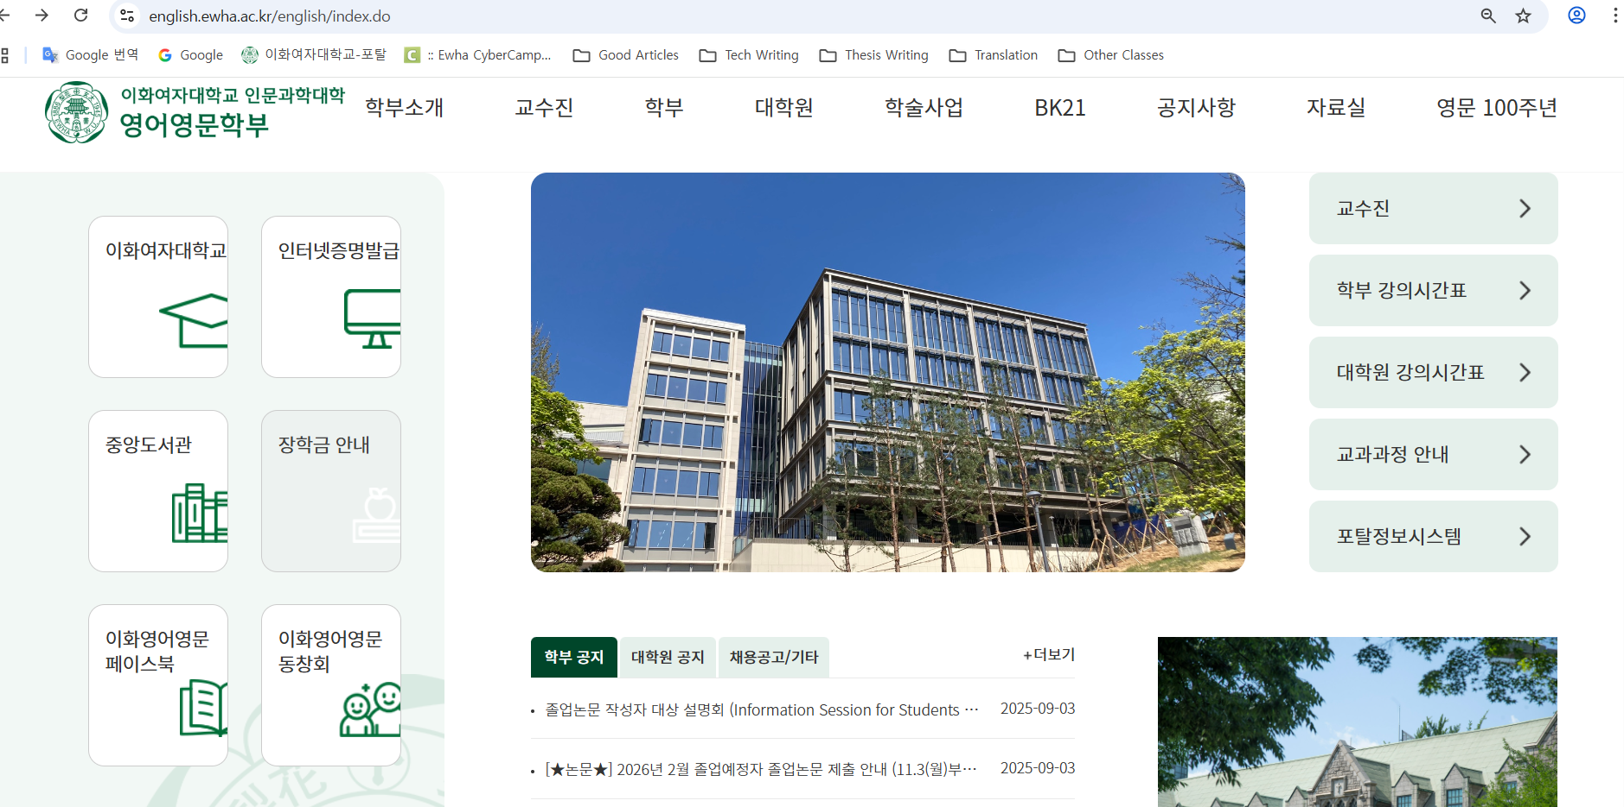
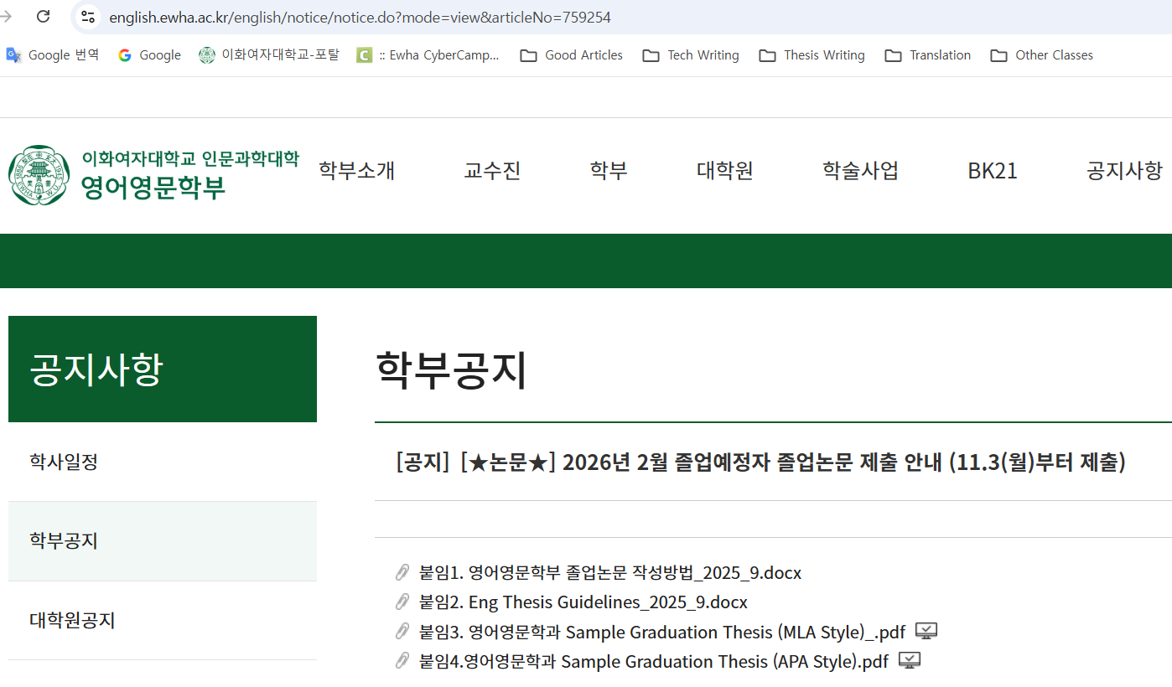
The Thesis Writing Process
Let the announcement on the English Department homepage be your guide.
https://english.ewha.ac.kr/english/notice/notice.do?mode=view&articleNo=759254

Slide 4
The Thesis Writing Process
Let the announcement on the English Department homepage be your guide.
https://english.ewha.ac.kr/english/notice/notice.do?mode=view&articleNo=759254
I’ll point out some highlights of the announcement and attachments. But, read everything so you get a more complete picture of what you should do to write your thesis.

Slide 5
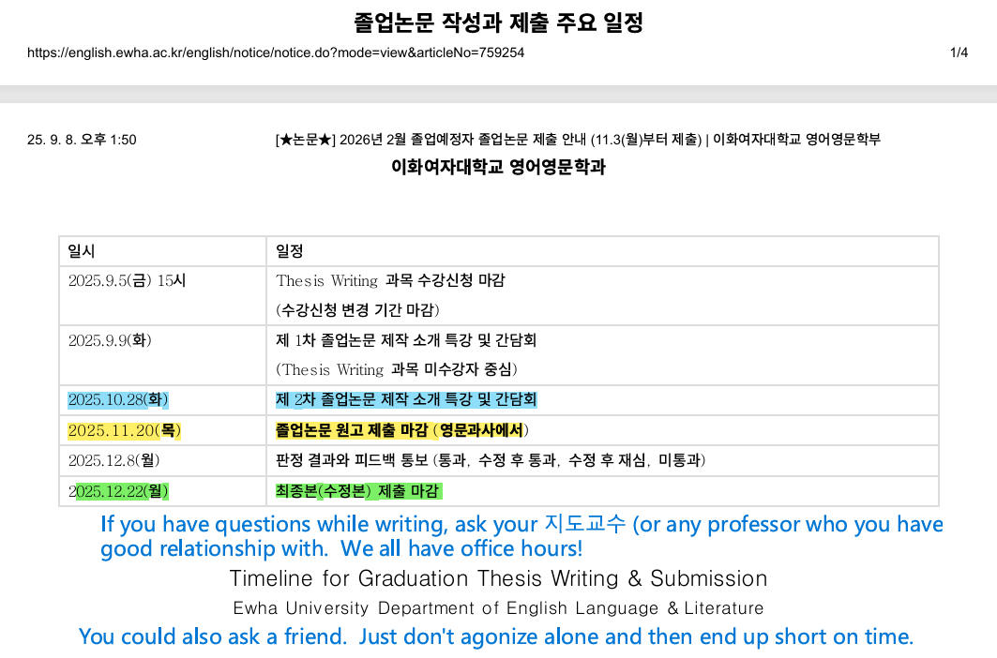
The Thesis Writing Process
Important Point #1: Don’t get behind schedule.
Important Point #2: Don’t isolate yourself.
Important Point #3: Follow procedures (see notes on PDF).

Slide 6
But what is a graduation thesis anyway?

Slide 7

But what is a graduation thesis anyway?

Slide 8
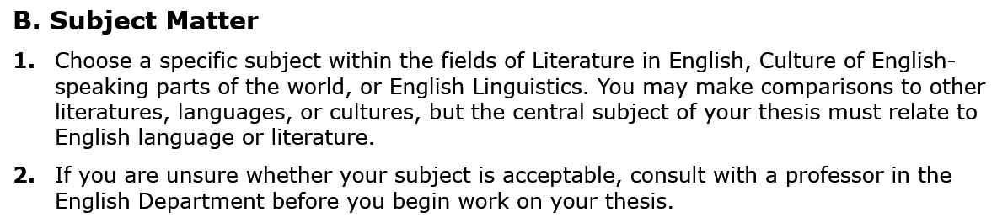
But what is a graduation thesis anyway?

Slide 9
But what is a graduation thesis anyway?
It’s usually easiest to start with a short paper you wrote for one of your English department classes and then expand your ideas with research and more analysis. Feel free to start with something new, though, if you’re inspired.

Slide 10
Main Types of Topics
a) a work of literature you like and want to talk about—what makes it artistic or important? (Note: “Work of lit.” isn’t limited to written lit.—it could be a TV show, movie, comic book, etc.)
b) a genre of literature (or a non-literary genre) or a particular author/director/performer/etc. that you want to talk about (it’s often easier to just focus on one representative work, though, rather than several)
c) a linguistic theory or trend that you can make a point about using some sort of analytical system (phonology, grammar, pragmatics, translation, etc.) and a set of examples to show your point
d) a cultural trend in the English-speaking world that you can make a point about using an analytical method and examples (e.g. blog postings, news articles, videos, etc.)
Key Point: You have to analyze something!

Slide 11
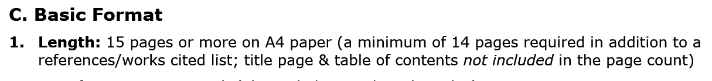
A few extra key requirements . . .

Slide 12
A few extra key requirements . . .

Slide 13
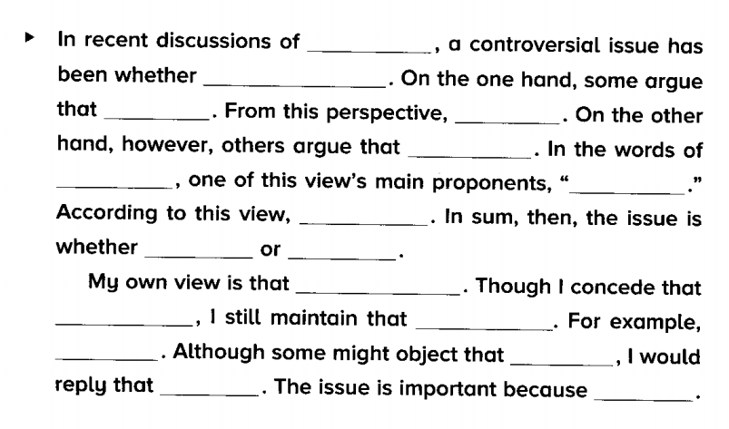
You can structure your introduction like this. (from They Say, I Say by Gerald Graff & Kathy Birkenstein)
Topic Intro.
Topic
A or B
Opinion A
A~
B~
Opinion B
Summary
A~~
B~~
~~C~~
Your new idea (C)–or new reasons to support side A or side B
Impact or importance of your topic.
This is called a “thesis/antithesis/synthesis” model. The body of the paper expands on and supports your idea.

Slide 14
Six Research Tips
a) Use the databases on the Ewha Library website, also Google Scholar (scholar.google.com). Try different combinations of key words to see what results you get.
b) The most useful papers will be ones that you disagree with. If there is a scholar arguing for something you disagree with, your whole thesis can center around your own view and develop evidence to support your view.
c) Probably you will find some people who support your view too. Hopefully they won’t say exactly the same things you wanted to say. To avoid that trap, be sure you think about your own ideas first and develop an idea you think will be new before you start research.
d) Ask AI to help you find sources and ideas. For example, if you want to write about the movie F1, you could ask AI something like this: “What are some aspects of film theory that movie critics of F1 have discussed. Where can I find academic papers about those theories?”

Slide 15
Six Research Tips
e) Useful sources for papers on literary works don’t even need to mention that particular work.
For example, thinking more about F1, suppose you want to argue that F1 makes a constructive critique of toxic masculinity. (This is a controversy that critics discuss about that film—I checked!) You should read a couple of reviews that discuss these issues (and cite those reviews in your paper). But, it may be as useful or even more useful to do search for papers that focus on more general topics like “portrayals of masculinity in American film and TV” or “American stereotypes of masculinity” or “changing views of masculinity in America” or “sociological analysis of toxic masculinity,” etc.
f) You need 5 academic sources—but it’s probably enough to find 2–3 that really connect to what you want to say and just throw in small details from 2–3 more.

Slide 16
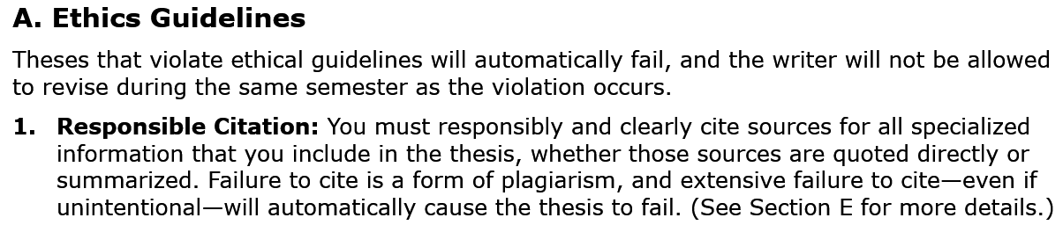
Avoiding Plagiarism: The Guidelines

Slide 17
Avoiding Plagiarism: The Guidelines
I would actually call this a rule—not just a guideline. If you make a small mistake, you won’t fail automatically. But, even with no intention to cheat, if you make many mistakes—or big mistakes—you will fail. So, learn how to cite other people’s ideas if you don’t know already.

Slide 18
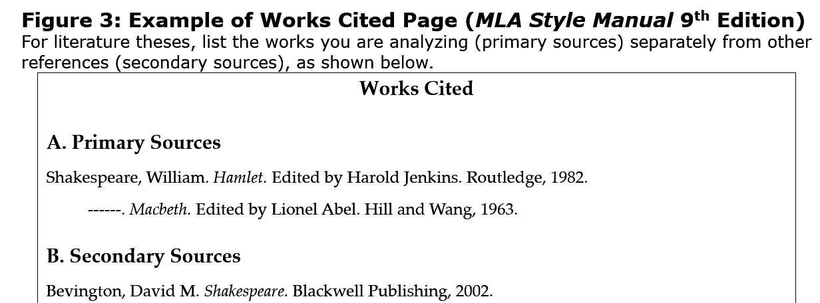
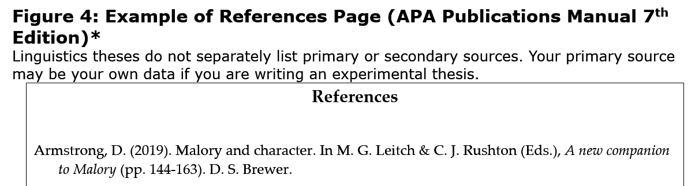
The thesis writing guidelines help.

Slide 19
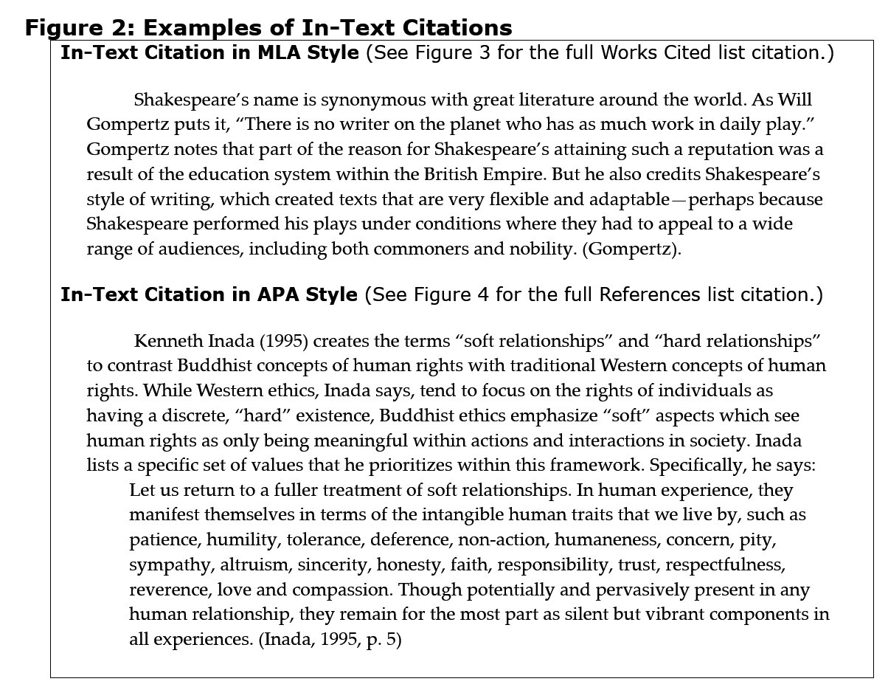
Actually, in-text citation is more difficult for most people. Learn to write this way.

Slide 20
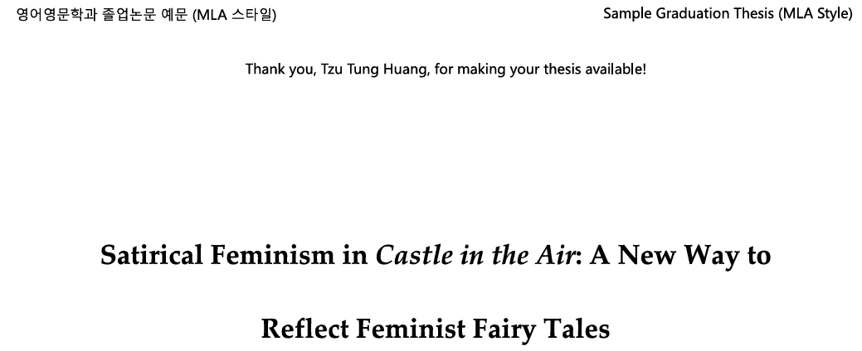
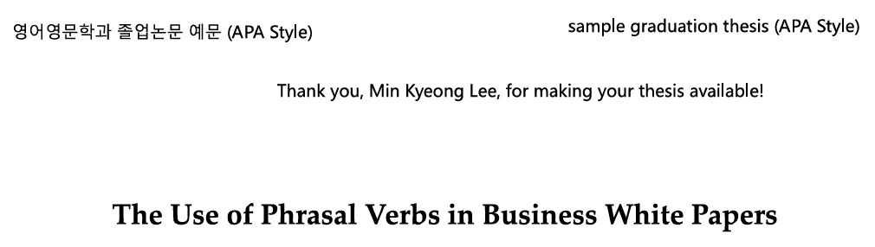
And, read the sample papers. (These are done in the latest style—so they are reliable about format.)

Slide 21
Quick Quiz: Do you need to cite?
a) You copy a paragraph of general background information about the main activities of early 20th century feminists in Britain from Wikipedia as part of a paper on the effects of World War I on feminism.
b) You state that the late 19th century in the U.S. was called the “Gilded Age” because there were many super-rich people who publicly displayed their wealth as part of your introduction to a paper on The Age of Innocence.
c) You read a paper about the development of Charles Dickens’ style from early to late novels and use the general plan of the paper to categorize your analysis of stylistic innovations in The Mystery of Edwin Drood.
d) A professor mentioned in class that the poems of Alfred Tennyson outsold the Bible in the late Victorian age. You mention that information in a paper about the public concept of the role of poetry in the 19th century.

Slide 22
Quick Quiz: Do you need to cite?
a) You copy a paragraph of general background information about the main activities of early 20th century feminists in Britain from Wikipedia as part of a paper on the effects of World War I on feminism.
b) You state that the late 19th century in the U.S. was called the “Gilded Age” because there were many super-rich people who publicly displayed their wealth as part of your introduction to a paper on The Age of Innocence.
c) You read a paper about the development of Charles Dickens’ style from early to late novels and use the general plan of the paper to categorize your analysis of stylistic innovations in The Mystery of Edwin Drood.
d) A professor mentioned in class that the poems of Alfred Tennyson outsold the Bible in the late Victorian age. You mention that information in a paper about the public concept of the role of poetry in the 19th century.
Yes
No
Yes
Yes

Slide 23
Q&A

Slide 24
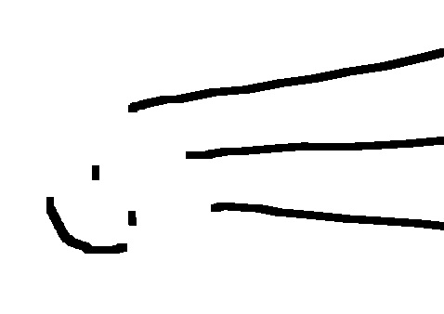
Final Reminder: If in doubt, ask a professor before it’s too late.
Good Luck!

